Slide 1
EE0005
MINI PROJECT:
Cardiovascular Disease
Group 3:
Lee Ray Chong
Logasan s/o Rajnthern
Qi XinYao
Wu Xiang Jie Kang

Slide 2
Table of Content
Problem Statement
Data Preparation
Exploratory Analysis & Visualization
Random Forest Classifier Model
Alternative Machine Learning Model
User Interface
Learning Outcome & Conclusion
Q & A

Slide 3
Problem Statement
What are the factors that leads to Cardiovascular Disease?
How are the factors related in predicting the possibilities of Cardiovascular Disease?
Preventative care application that can predict the possibilities of Cardiovascular Disease in the community level.
Notes:
CVD is the number 1 cause of death globally. More people die annually from CVD as compared to any other disease. Therefore, this made our team to look into this particular issue. We want to find out are the factors that leads to CVD and how are these factors affecting in predicting the possibilities of having CVD.
We intent to come up with a Preventative care application that can predict the possibilities of having CVD.

Slide 4
Objective
Our objective is to use multiple objective, examination and subjective features to predict the possibilities of Cardiovascular Disease.
Notes:
Our objective is to use these 11 variables to predict the possibilities of CVD.
I will touch on the individual variables on the following slide.

Slide 5
Cardiovascular Disease Data Set
Objective Features
Weight (kg) Height (cm)
Gender (M/F) Age (Days)
Target Variable :
Absence or Presence of Cardiovascular Disease
Examination Features
High Blood Pressure (mmHg) Low Blood Pressure (mmHg)
Cholesterol level (1/2/3) Glucose level (1/2/3)
Subjective Features
Alcohol Consumption (Y/N) Smoking Habit (Y/N)
Physically Active (Y/N)
1 - Normal, 2 - Above Normal, 3 - Well Above Normal
Notes:
Objective Features are factual information
Examination features are given by doctor in the medical report.
Subjective features are information directly answered by the patients
Using the 11 variables, we predict the presence and absence of Cardiovascular Disease

Slide 6
Data Preparation

Slide 7
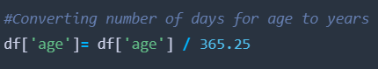
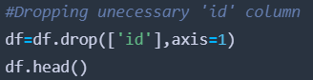
Data Preparation
Converting Age from Days to Years
Drop the Id column
Train Set = 70%
Test set = 30%
Notes:
I would like to highlight the 3 parts of the data cleaning process.
Some of the variable in the data set were not in the proper format that we wanted, for example the age. We converted from days to years.
We also removed those unwanted columns such as Id to solve the problem.
We split the data set into

Slide 8
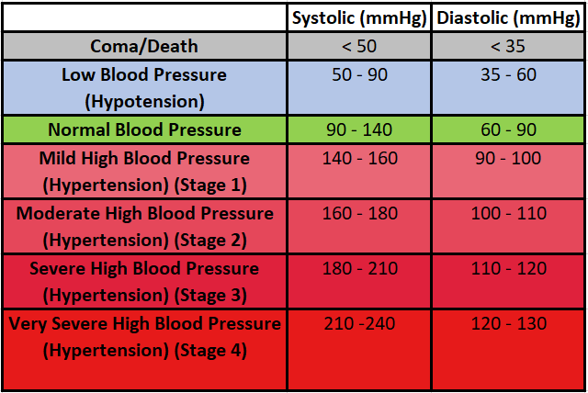
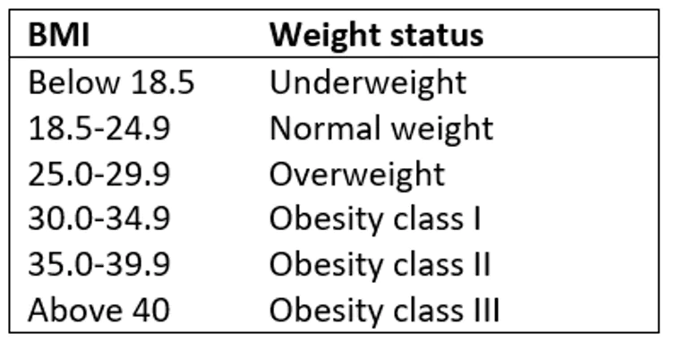
Suitable Ranges of BMI & Blood Pressure
Highest Systolic (ap_hi): 240
Lowest Systolic (ap_hi): 50
Highest Diastolic (ap_lo): 130
Lowest Diastolic (ap_lo): 35
Lowest Acceptable BMI: 18.5 - 4.9 ≈ 14
Highest Acceptable BMI: 40 + 4.9 = 44.9

Slide 9
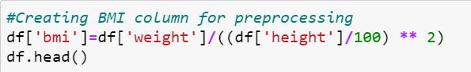
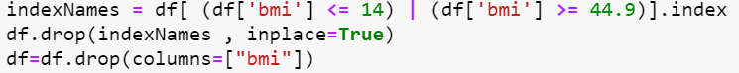
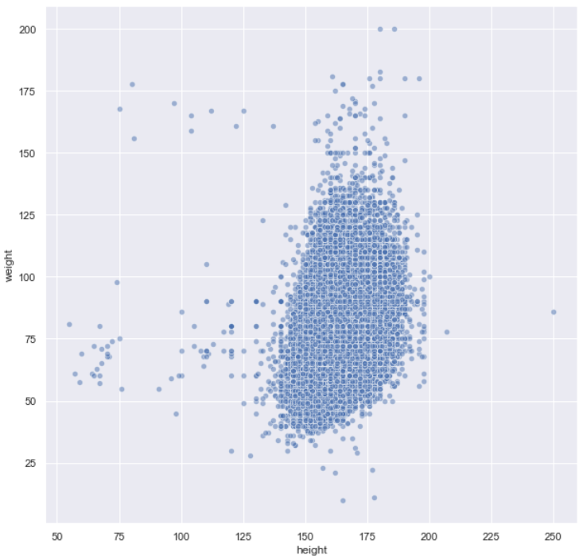
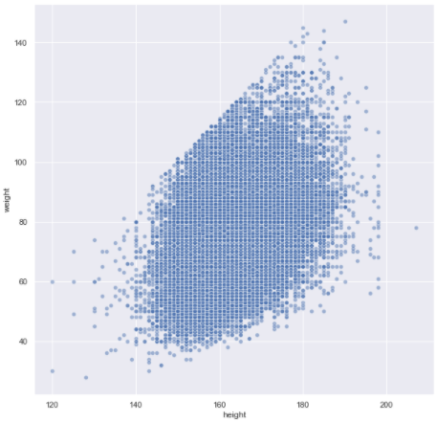
Height vs Weight

Slide 10
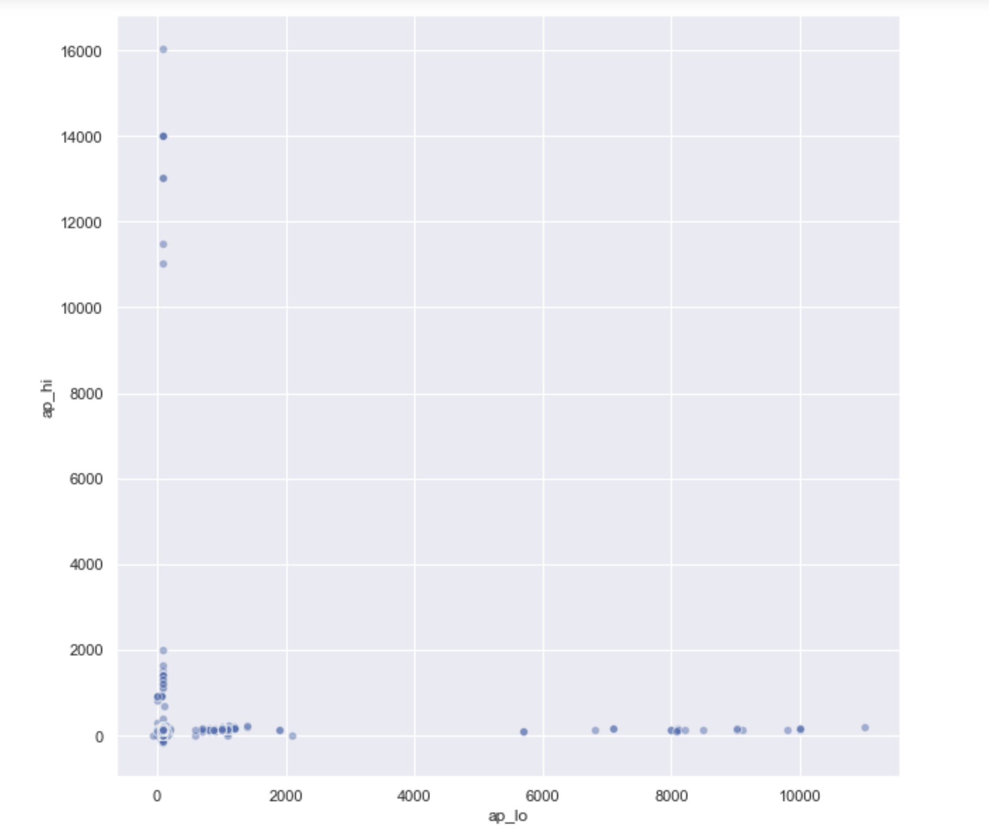
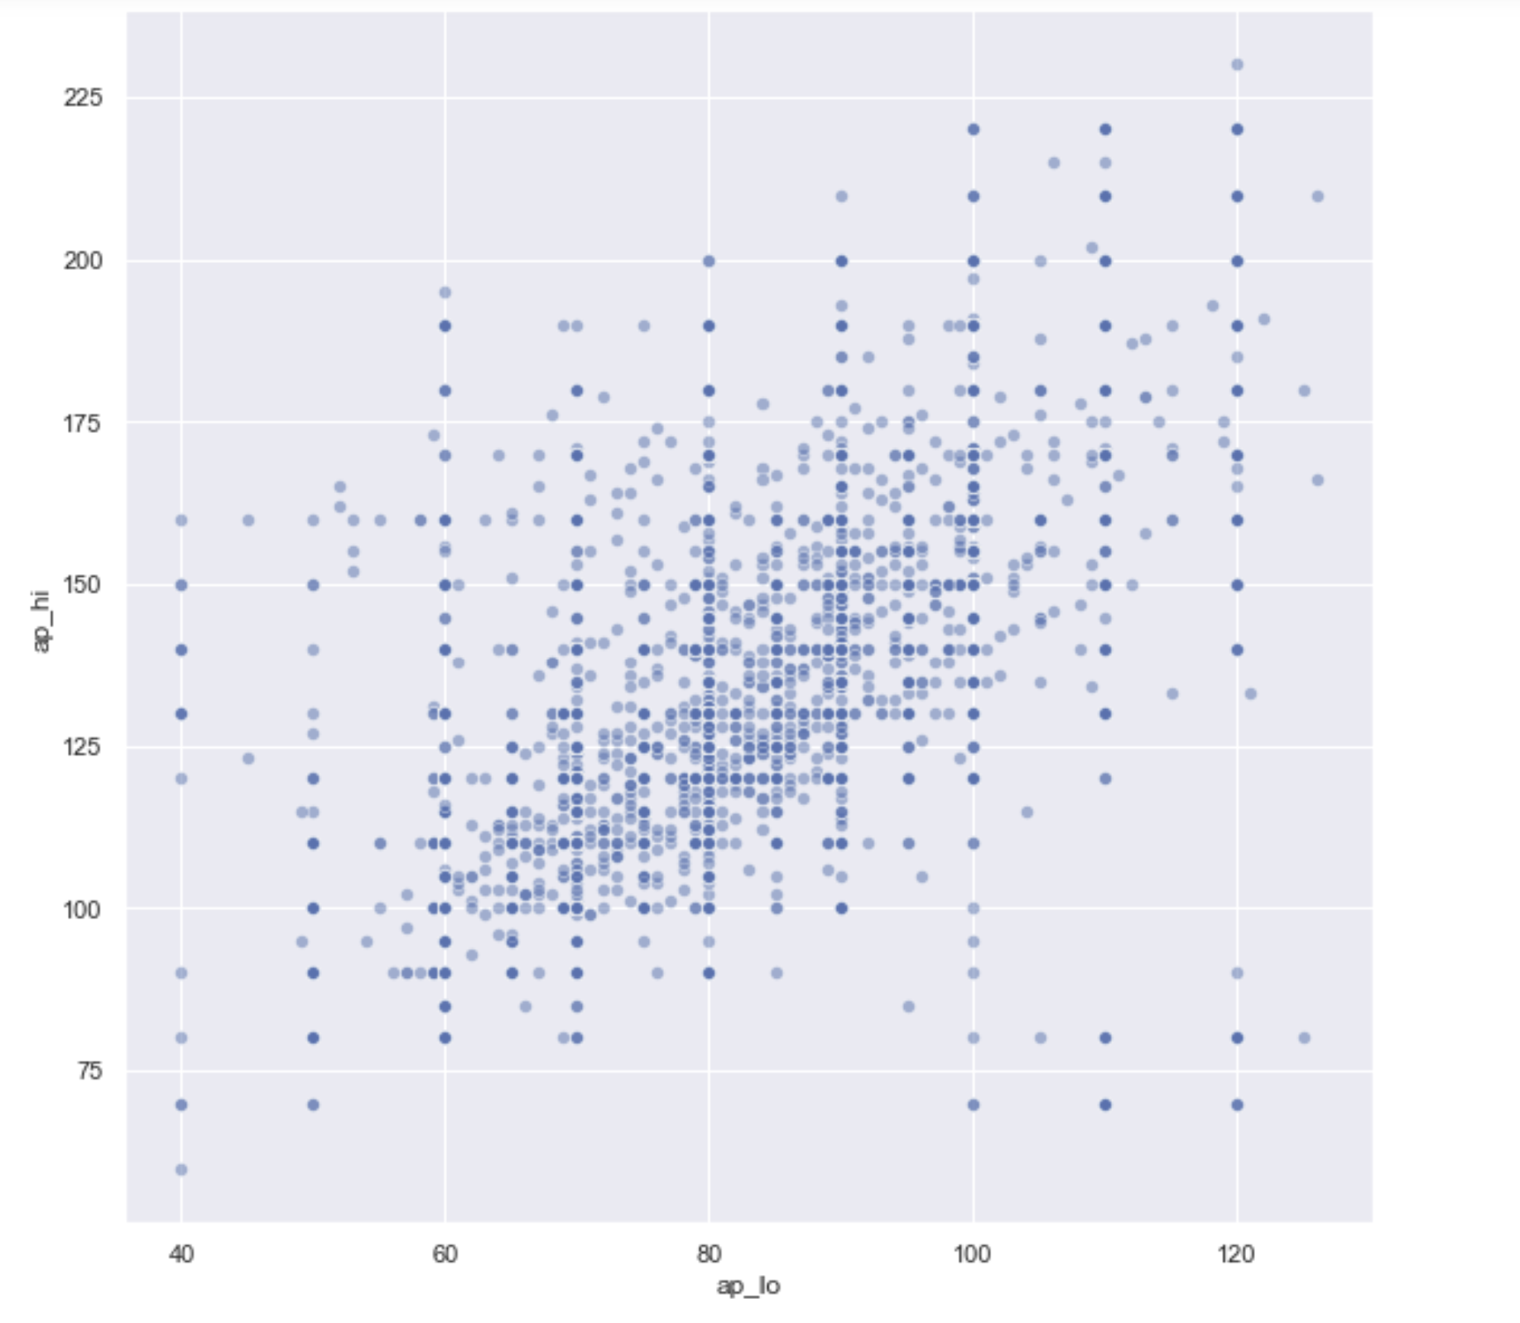
Systolic blood pressure (ap_hi) vs Diastolic blood pressure(ap_lo)

Slide 11
Exploratory Analysis & Visualization

Slide 12
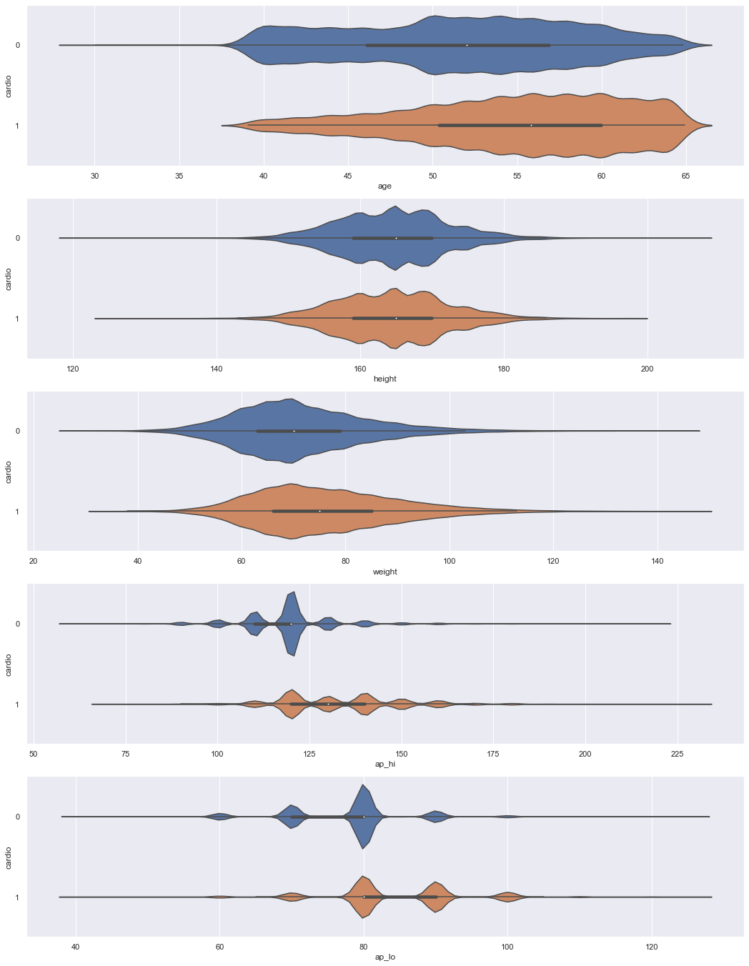
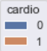
Violin Plot
Age
Height
Cardio
Low
High
Weight
Systolic
Diastolic

Slide 13
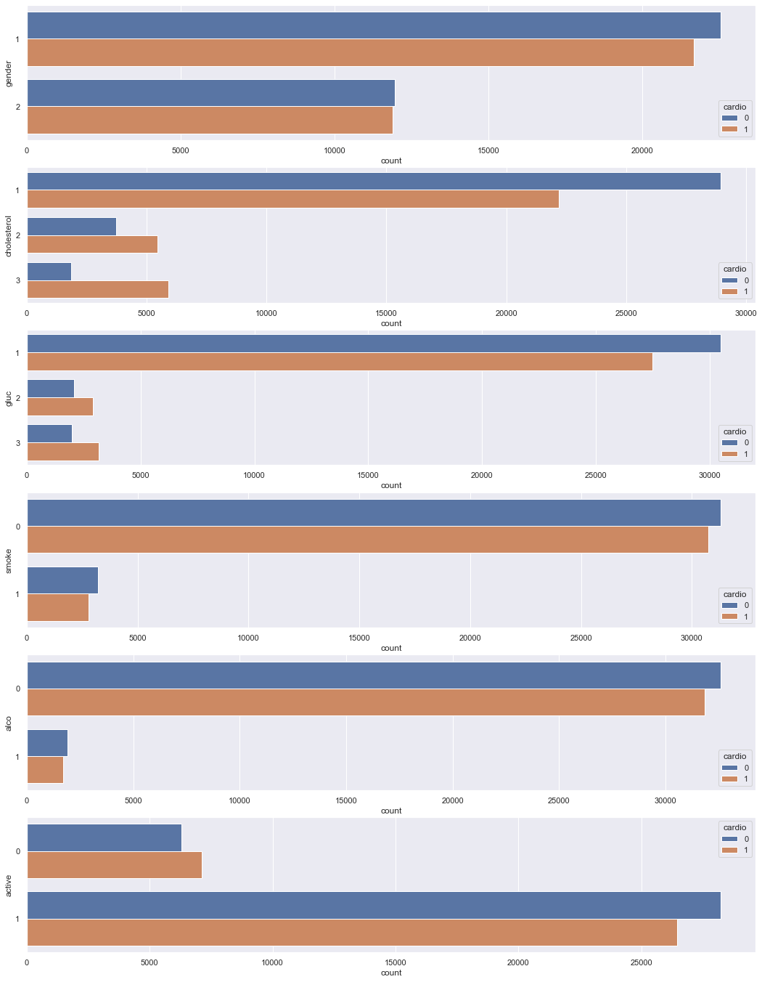
Count Plot
Gender
Cholesterol Level
Glucose Level
Cardio
Low
High
Smoking Habit
Alcohol
Physically Active

Slide 14
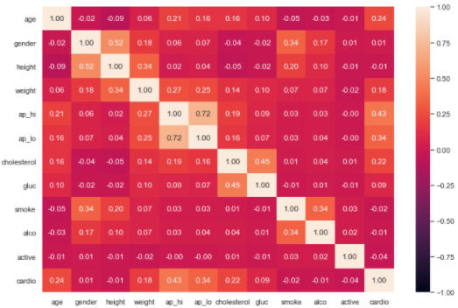
Correlation Heat Map

Slide 15
Ensemble Learning: Random Forest Classifier

Slide 16
Type of problem
Since the target variable is binary, the ML model used will be using a classification algorithm
Decision Tree
Logistic Regression
Random Forest Classifier

Slide 17
Random Forest Classifier
Bootstrapped data 1
Decision Tree 1
Bootstrapped data 2
Decision Tree 2
Voting Aggregation
(Majority Vote)
Target Variable
Feature Data
Bootstrapped data n
Decision Tree n

Slide 18
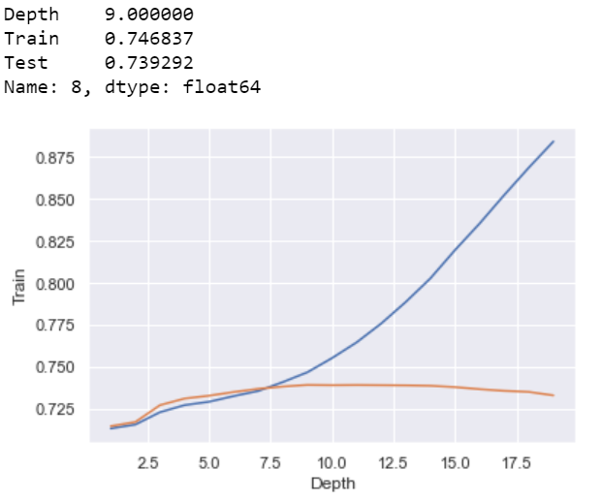
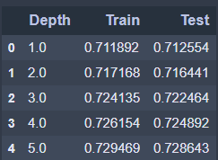
Hyperparameter tuning for Random Forest Classifier

Slide 19
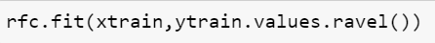
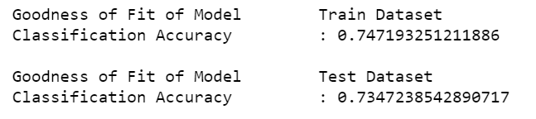
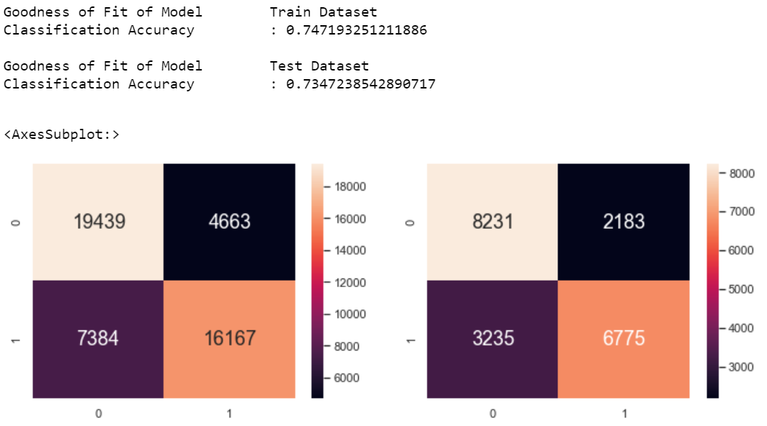
Hyperparameter tuning for Random Forest Classifier

Slide 20
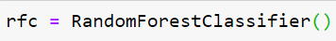
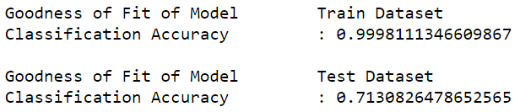
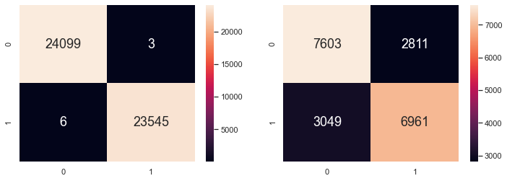
Random Forest Classifier Accuracy
The Overall Classification Accuracy is increased by 2.945%

Slide 21
Alternative Machine Learning Methods

Slide 22
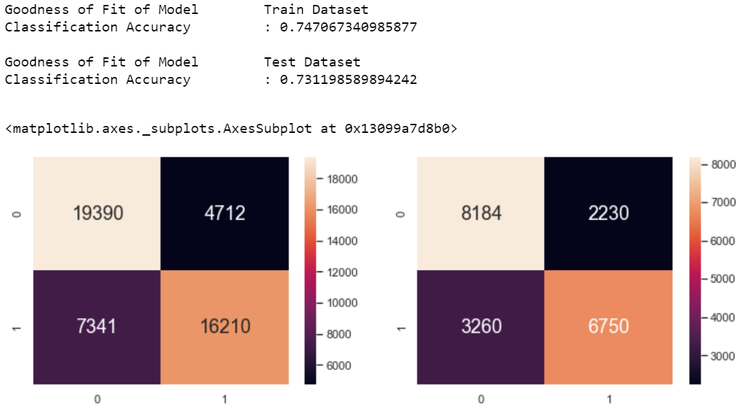
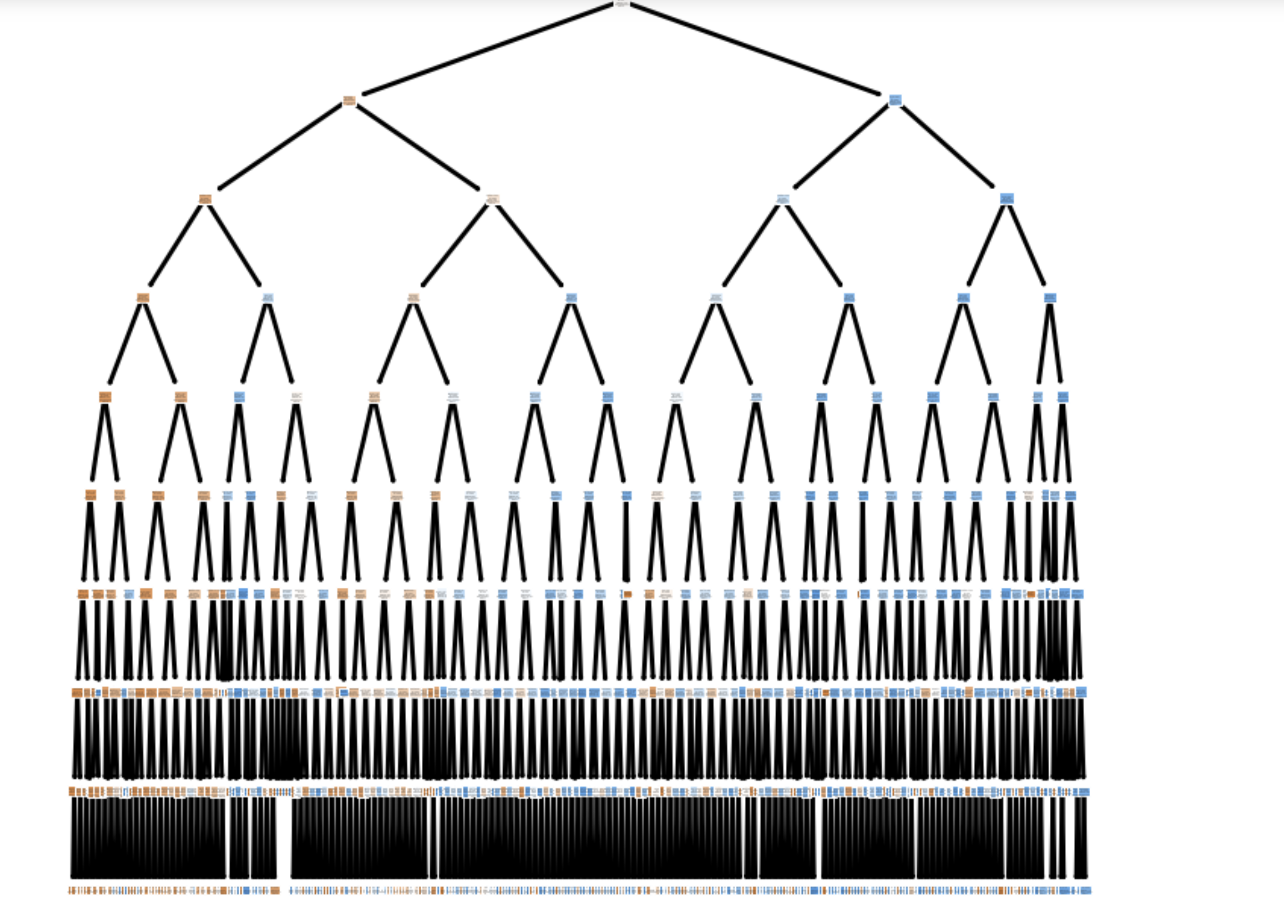
Decision Tree Model

Slide 23
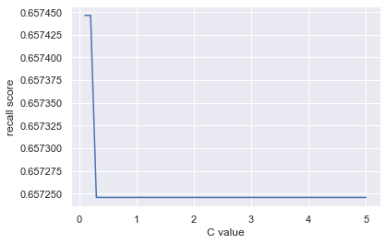
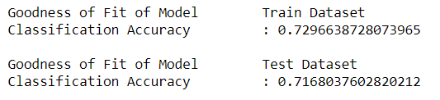
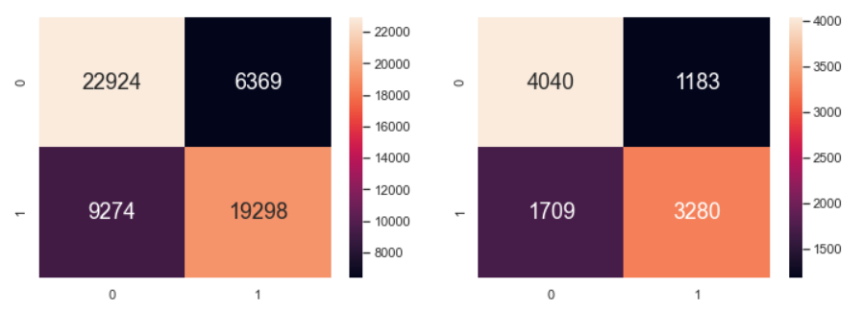
Logistic Regression Model

Slide 24
User Interface

Slide 25
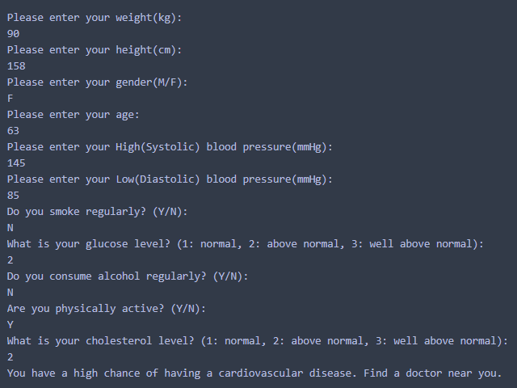
User interface

Slide 26
Learning Outcome & Conclusion
Learning new data preprocessing methods
New machine learning models (e.g. Random Forest Classifier & Logistic Regression)
Learning about overfitting and regularisation techniques to
Hyperparameter tuning for a particular Machine Learning model
Learning the definition of different parameters in Machine Learning model
Finding the best Machine Learning model for different types of data (e.g. Numeric, Categorical and Binary)
Creating a User Interface

Slide 27


Slide 28


